Slide 1

MACHINE LEARNING
PROJECT: FOOD(DOODLE) PREDICTOR

Slide 2
OBJECTIVE OF THE PROJECT
The user makes a drawing(doodle) and our model makes a guess of what item in the menu the doodle closely resembles to.
The menu contains food items like pizza, ice-cream, etc.

Slide 3
DATASETS
Drawings(Doodles) of food items in our menu.
We have a separate folder of datasets for each food item.
The dataset was collected from Google Quickdraw Dataset.

Slide 4
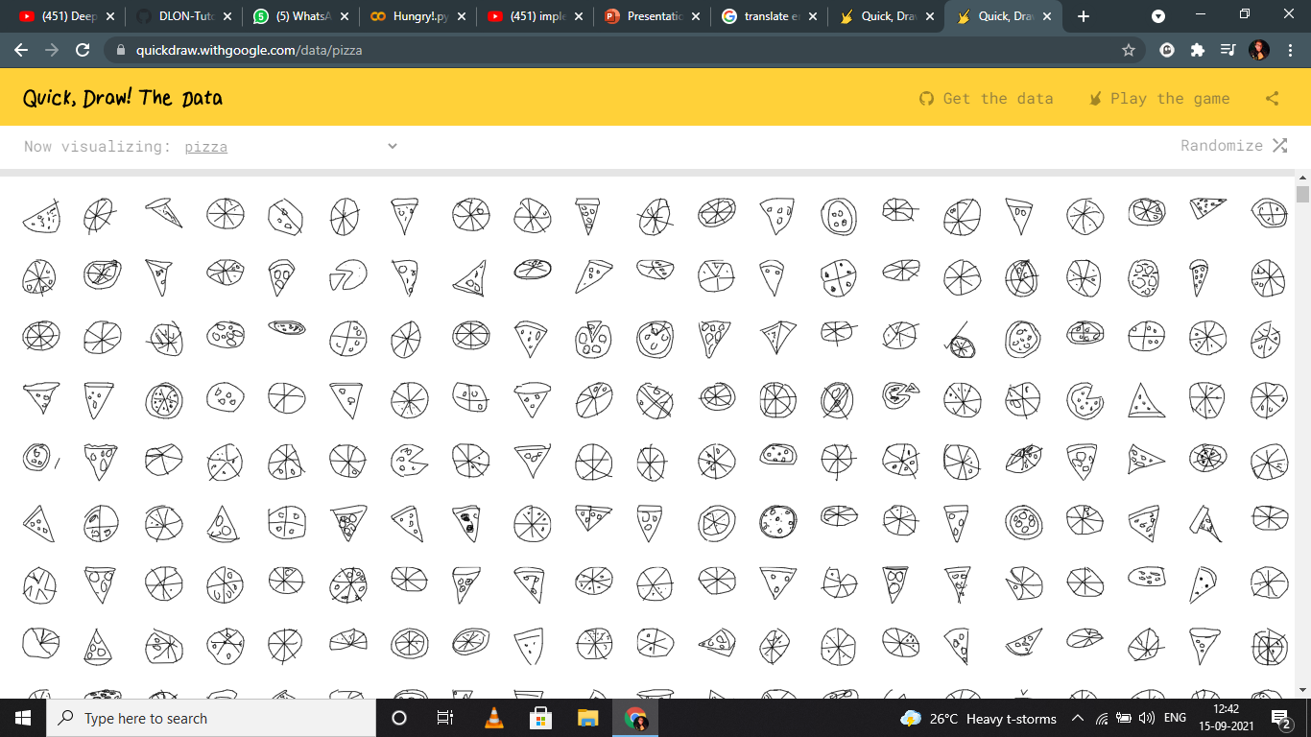

Slide 5
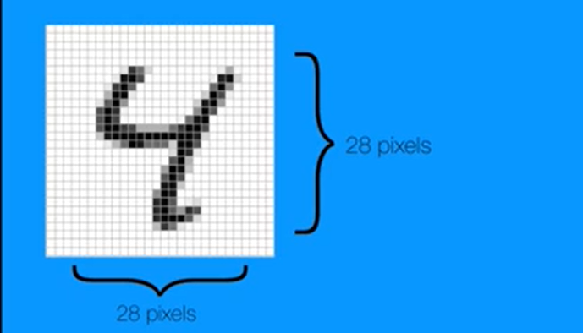
PRE-PROCESSING
In data pre-processing we convert our datasets images into NumPy arrays(28x28), and give them appropriate labels like pizza, ice cream or hotdog.

Slide 6
MACHINE LEARNING ALGORITHM
We can use Normal multilayer perceptron network or Convolutional neural network.
We use CNN(Convolutional Neural Network) algorithm as a machine learning algorithm because when applied to image datasets CNN tends to perform much better.
CNN is a Deep Learning algorithm which takes an image as input and applies filter to extract the feature.
The neural network then uses these features to generate the output.

Slide 7
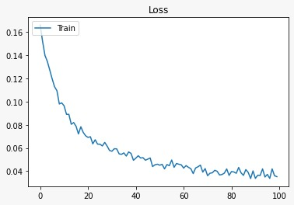
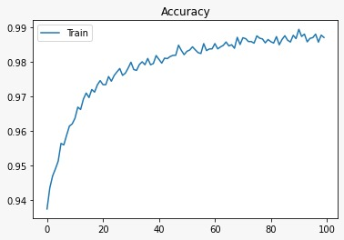
TEST RESULTS
When trained with 100 Epochs

Slide 8
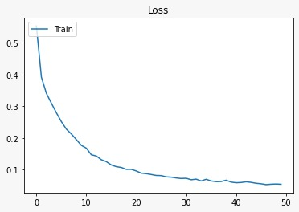
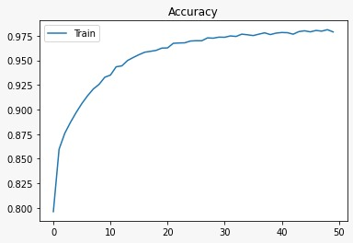
TEST RESULTS
When trained with 50 Epochs

Slide 9

Thank You
Created by-
Mihir Zalavadiya(180280107127)
Himanshu Tatamiya(180280107122)

